Slide 1
Django Framework Web Development
Group Members:
Alex Leung
Ricky Chan
Kim Chan
Sage Chau

Slide 2
Run-down
Existing Site
New Site Walkthrough
Design
Site Map & UML
Technical Appraisals – Frontend
Technical Appraisals – Backend
Donations
Deployment –AWS
Development Tools

Slide 3
Introduction
觀塘民聯會
Old-styled design
Outdated information
Scattered news
Segmented platforms

Slide 4
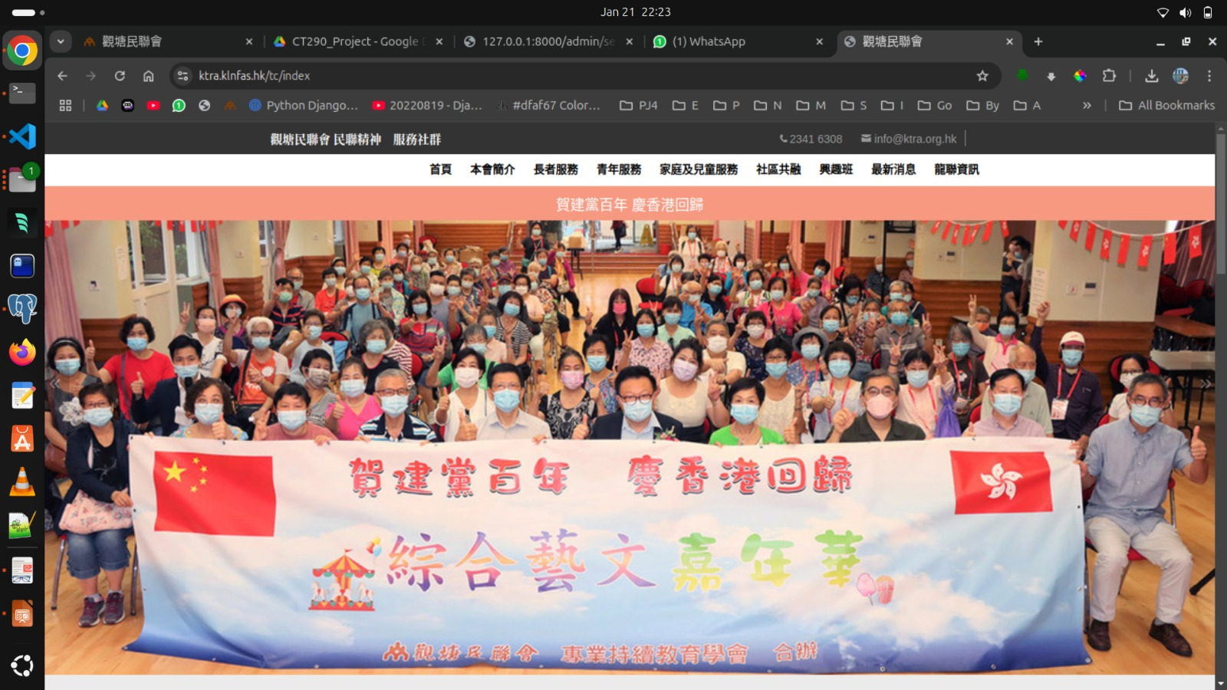
Overview of Existing Site
https://ktra.klnfas.hk/tc/index

Slide 5
Improvement
Here is a list of improvements the new web site have over the existing one
1st | 2nd | 3rd | 4th | 5th | 6th
Fast | Unified | Design | Easy Booking | CRUD | Flexible Layout
Less Response Time | One web site Serves all purpose | Contemporary Design will Attract more young people | Booking becomes incredibly easy and fast promoting more participation | Staff will have a easier time to update the web pages and events | The use of bootstrap classes makes viewing of large and small screens equally assesible

Slide 6




Design - color
#F79880
Salmon
Existing Web Site
One primary colour plus
two secondary colours
#DFAF67
Necrophilic
Brown
#F79880
Autumn Mist

Slide 7
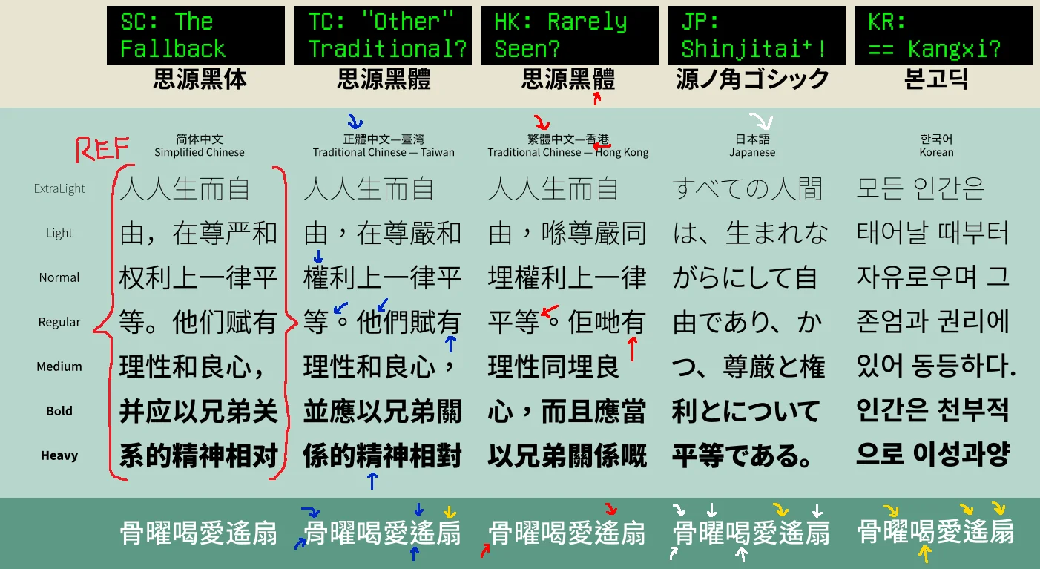
Design - Fonts
Noto Sans
Hong Kong

Slide 8
Design – Elderly
Larger text
Large showcase
Flexible layout
Carousel display for automatic scrolling

Slide 9

Design – Elderly Font Size

Slide 10

Design – Elderly, Large showcase

Slide 11
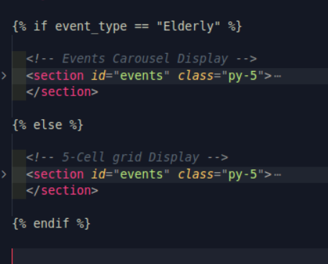
Design – Elderly, Carousel

Slide 12
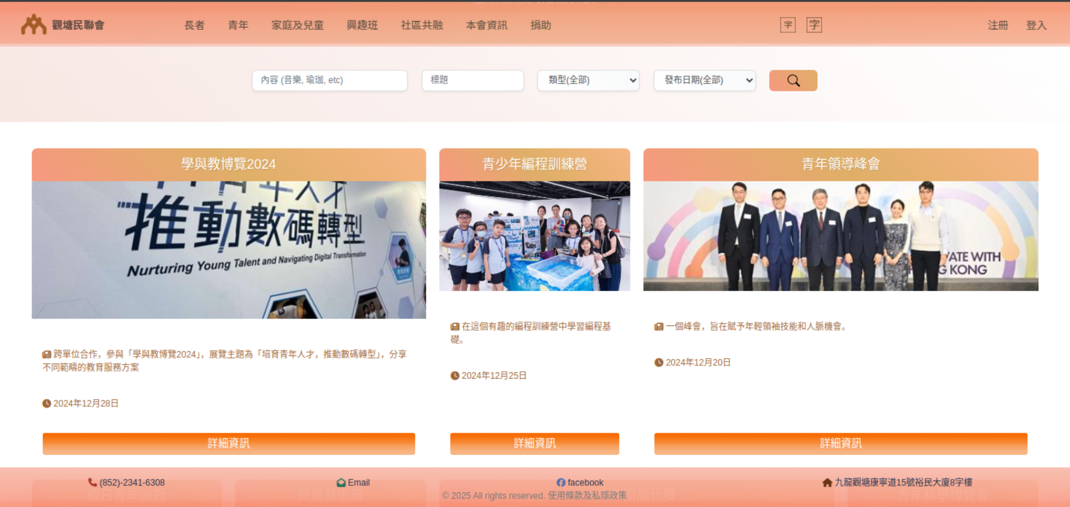
Design – Elderly, Flexible Display

Slide 13
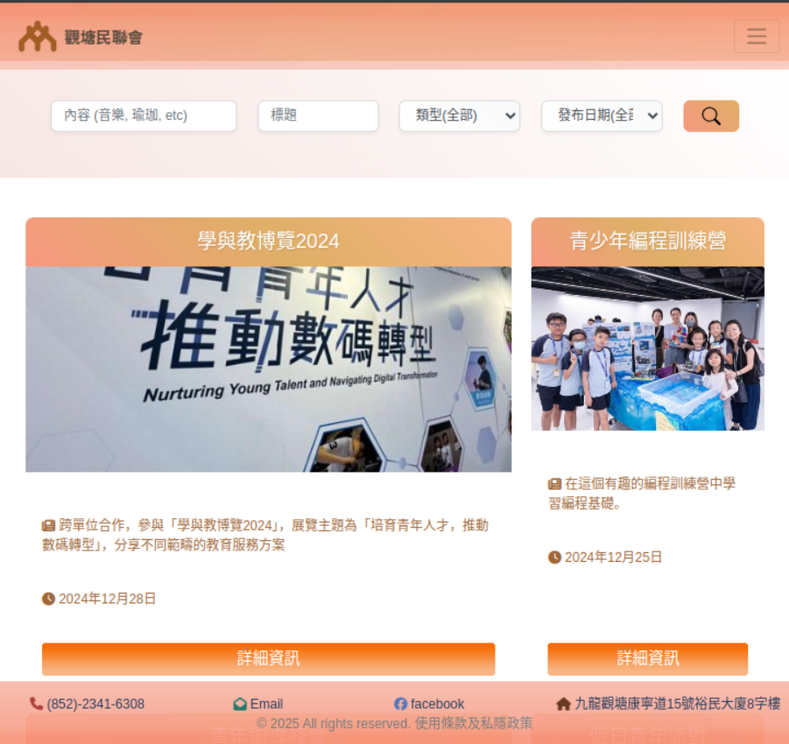
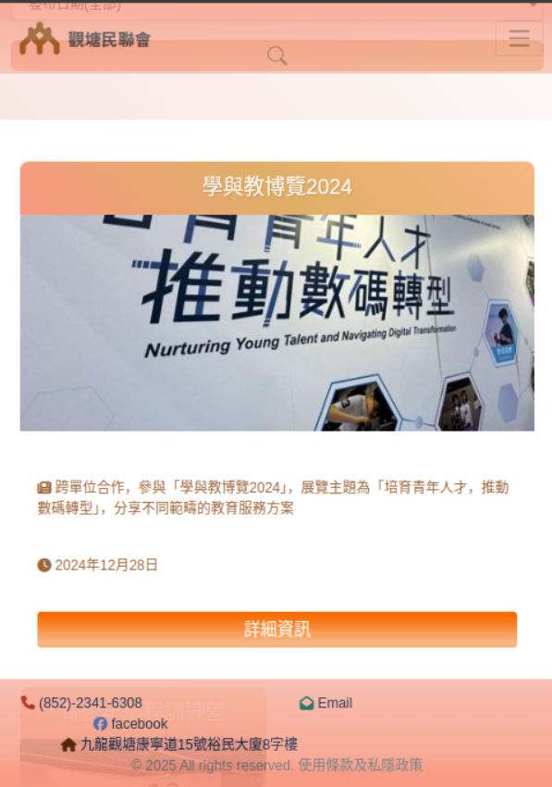
Design – Elderly, Flexible Display

Slide 14
Site Map

Slide 15
UML – Class Diagram Organization Chart

Slide 16
UML – Class Diagram
Event
+id: int(PK)
+title: string
+type: string
+content: string
+date: datetime
+is_publish: Boolean
+photos: image
Service
+id: int(PK)
+title: string
+type: string
+descriptions: string
+date: datetime
+start_time: datetime
+end_time: datetime
+fee: int
+quota: int
+is_publish: Boolean
+photos: image
Booking
+id: int(PK)
+title: string
+service: int(FK)
+user: int(FK)
+date: datetime
User
+id: int(PK)
+username: string
+email: string
+date_join: datetime
+is_active: Boolean
+is_staff: Boolean
+is_superuser: Boolean

Slide 17
UML - User Activity Diagram

Slide 18
UML - Activity Diagram Inactive Timeout
success message

Slide 19
Technical Appraisal - Frontend
HTML, CSS, JS, snippet of code
Color Gradient - demonstration
Bootstrap flex grip 5 col, VP 95
Carousel
Flex layout
Demonstration of CRUD
Inspection panel
Order of execution CSS

Slide 20
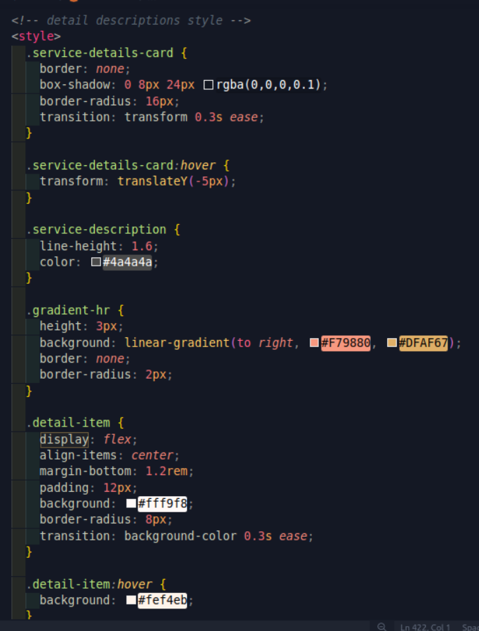
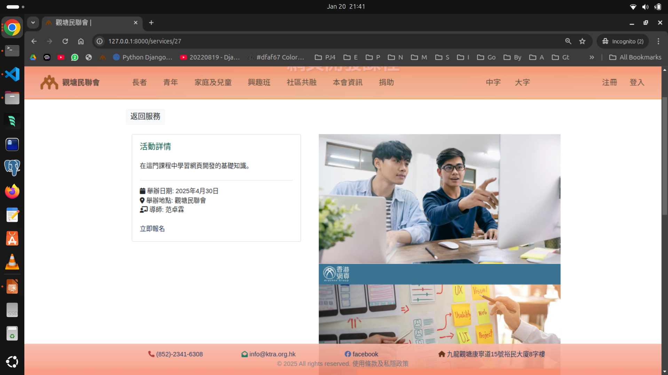
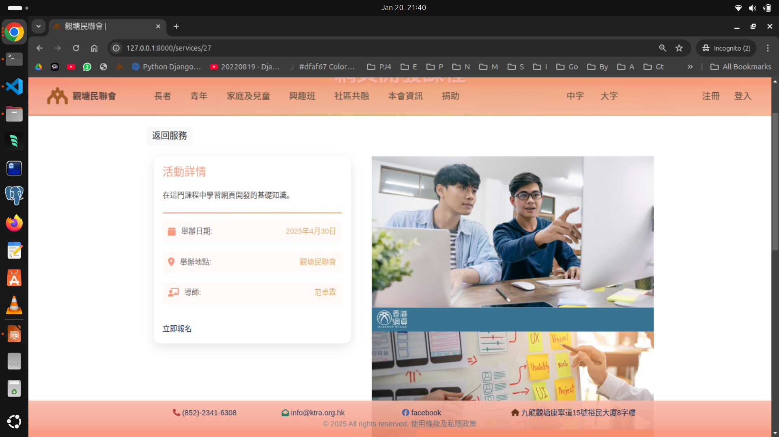
CSS Styling
Dressed-up otherwise planed and dull HTML
Without CSS
With CSS

Slide 21
CSS Styling – color gradient
.bg-primary11 { background-image: linear-gradient(180deg, rgba(247, 145, 120, 1) 15%, rgba(247, 160, 138, 1) 30%, rgba(247, 165, 144, 1) 45%, rgba(247, 169, 150, 1) 55%, rgba(247, 173, 155, 1) 70%, rgba(247, 178, 161, 1) 85%, rgba(247, 186, 171, 1) 100%);}
.bg-primary12 {background-image: linear-gradient(0deg, rgba(247, 145, 120, 1) 15%, rgba(247, 160, 138, 1) 30%, rgba(247, 165, 144, 1) 45%, rgba(247, 169, 150, 1) 55%, rgba(247, 173, 155, 1) 70%, rgba(247, 178, 161, 1) 85%, rgba(247, 186, 171, 1) 100%);color: #212529; }
.btn-secondary { color: #212529; /* dark text color */ background-color: transparent; /* background-image: linear-gradient(180deg, rgba(247, 160, 138, 1) 15%, rgba(247, 164, 143, 1) 30%, rgba(247, 167, 147, 1) 45%, rgba(247, 169, 150, 1) 55%, rgba(247, 171, 152, 1) 70%, rgba(247, 175, 157, 1) 85%, rgba(247, 178, 161, 1) 100%); */ border:0px }

Slide 22
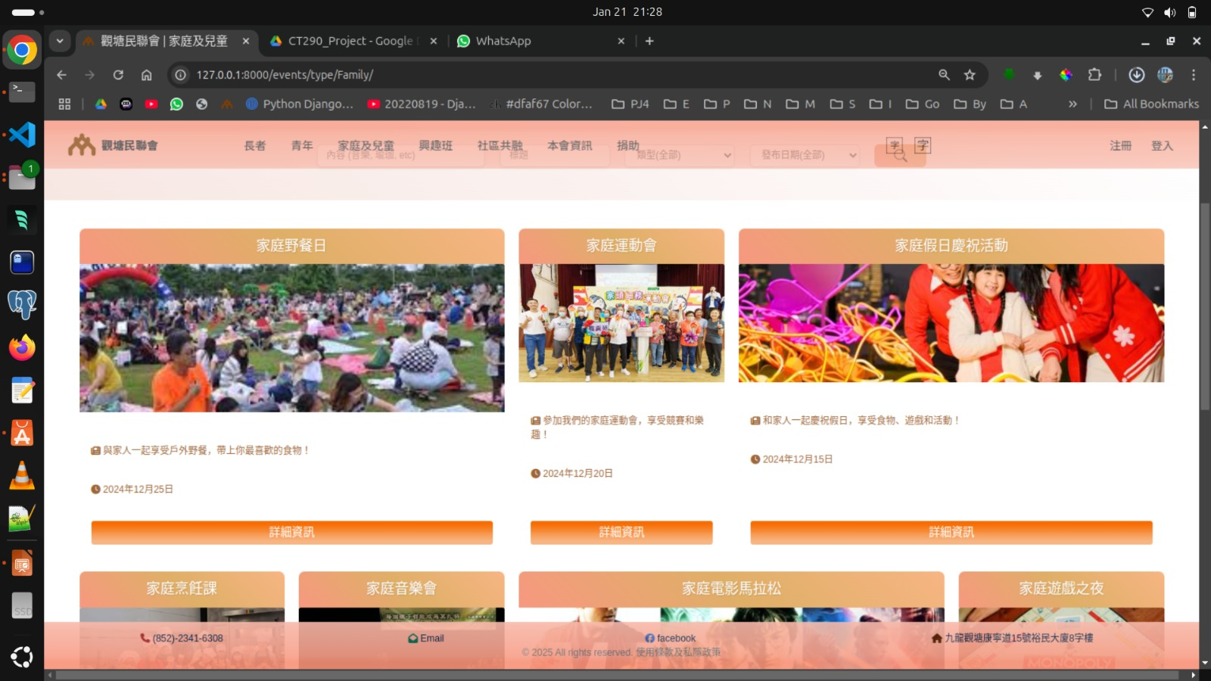

Slide 23
Javascript
Give the vibrance to the web page, e.g.
Carousel
Text Sunrise effect
Animation

Slide 24

Bootstrap Flex Grid

Slide 25

Bootstrap Flex Grid

Slide 26
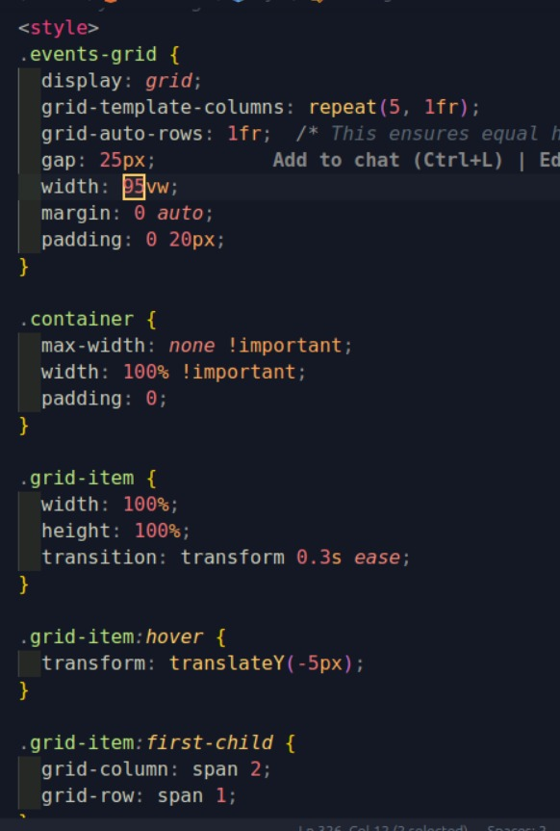
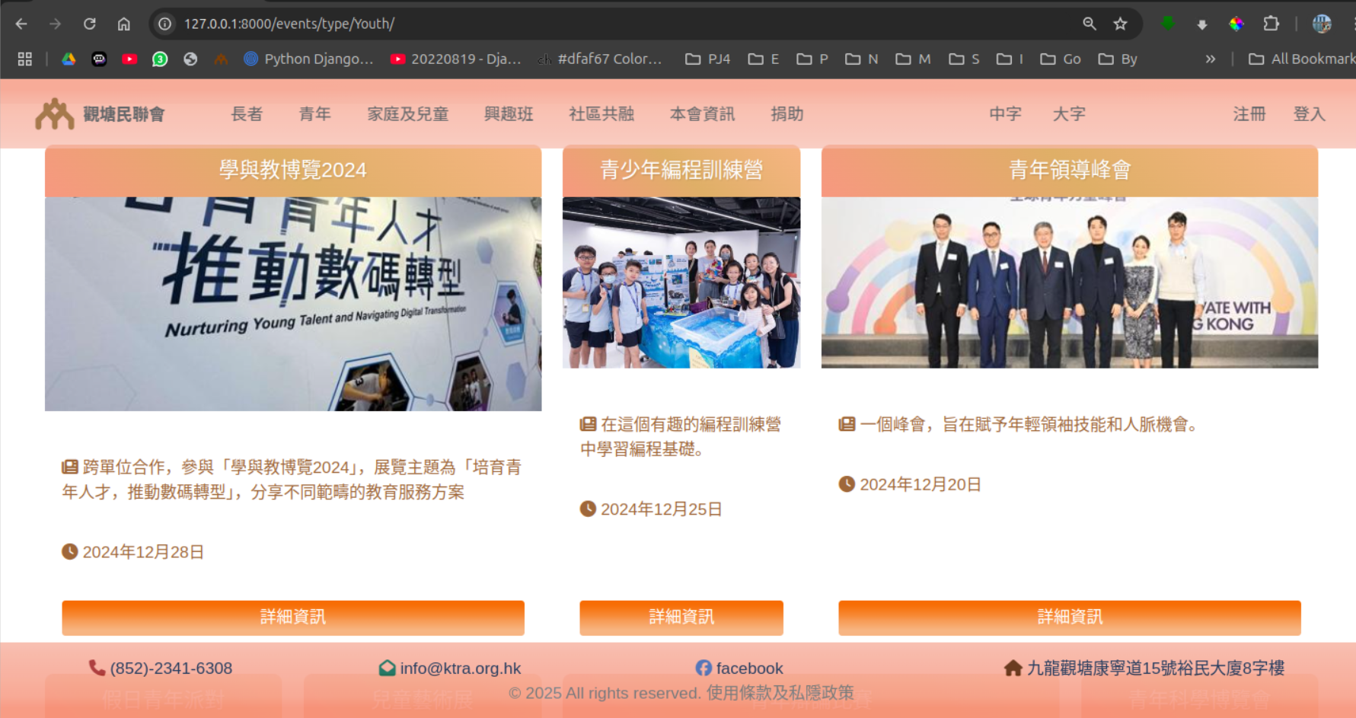
Bootstrap Flex Grid, 95vw

Slide 27
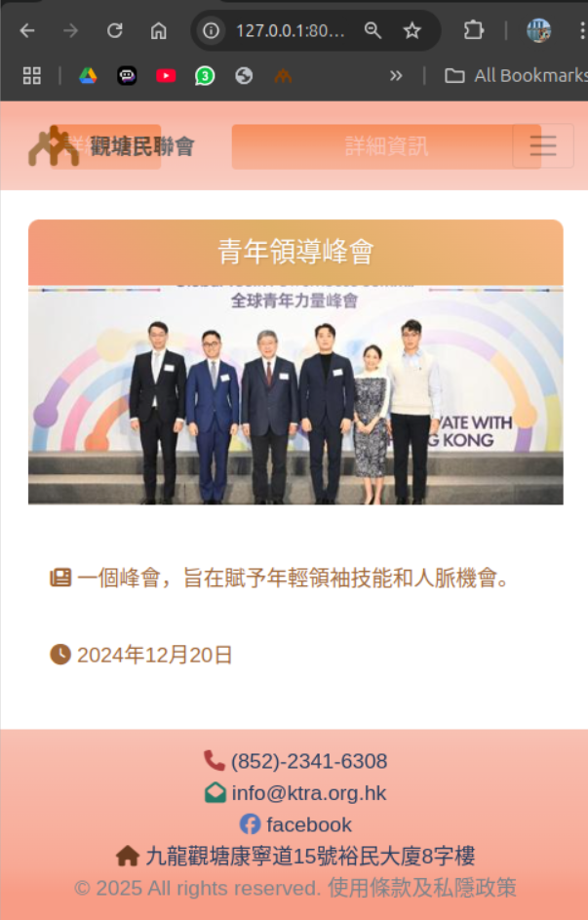
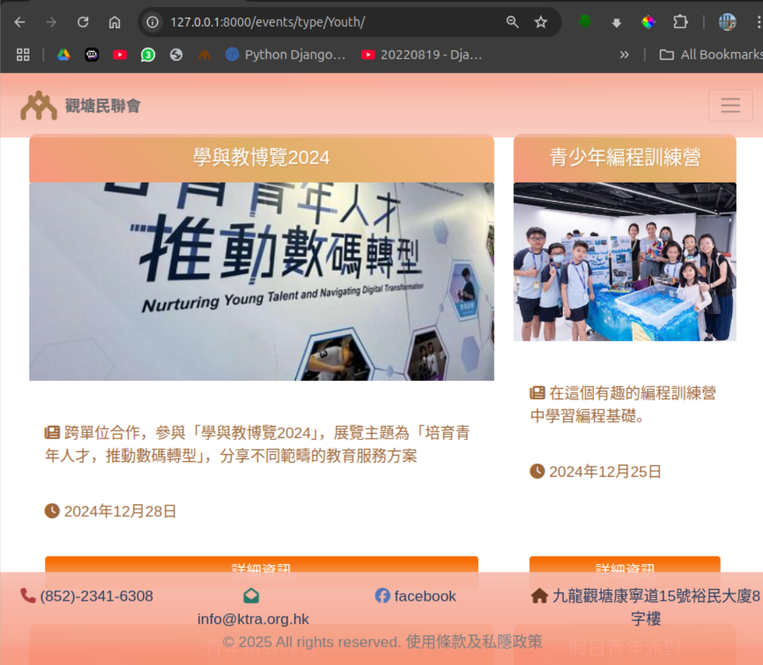

Slide 28
Bootstrap Flex Grid – why use?
Abundant Display - user can assimilate multiple events in a glance
Flexible display - Changed in different screens sizes,
Display of cells can be in different combinations, 2X1, 3X1, 1X2, 2X2, etc, flexibility in highlights on various levels of important events.

Slide 29
Technical Appraisal - Backend

Slide 30
Technical Appraisal - Backend
1. Django Framework
2. The Power of Django ORM
3. Django for CRUD
4. Optimum Functions

Slide 31
Django Framework
ORM (Object-Relational Mapping): Allows developers to interact with the database using Python objects instead of writing raw SQL queries.
Admin Interface: A built-in admin panel that provides a user-friendly interface to manage the application's data.
Authentication: Built-in user authentication and authorization mechanisms.
Long-term support.

Slide 32
The Power of Django ORM
Traditional method - more code, and more difficult to interact with database
ORM - less code, more effective, directly control Database without SQL

Slide 33
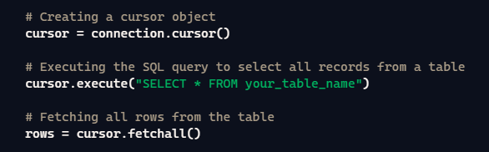
Traditional vs ORM
VS

Slide 34
Pages Employing ORM
C - Create:
Object Create Function/Class.save() - Register, Booking
R - Read:
Queryset - Index, Services, Service, Service-Search, Event, Events, Event-Search, Dashboard,Login, Register, Booking, nearly every single page in the KTRA view and Build-in Admin interface.
U - Update:
Build-in Admin interface
D - Delete
Build-in Admin interface

Slide 35
Optimum Functions
General Information context_processors
Auto Logout
Full quota function
Where to login , Where to redirect
Future Enchant:
All web page data (Include Image) control by CMS(Build-in Admin Interface)

Slide 36
Donations

Slide 37
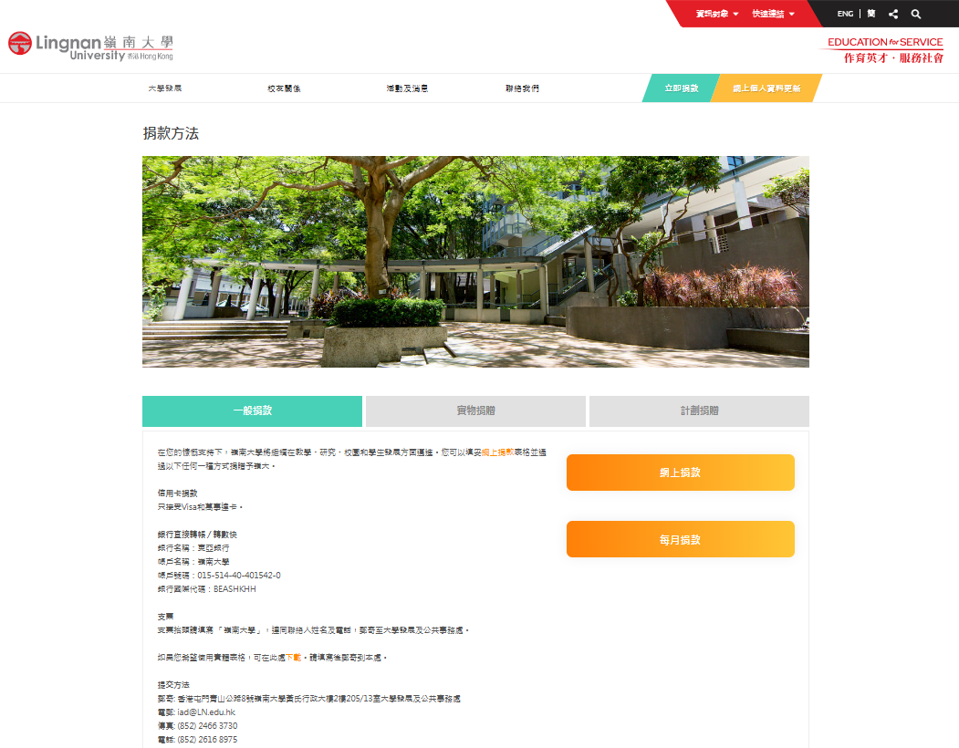
Web Design Reference
Lingnan University donations page - simple and minimalist design with a big donations button

Slide 38
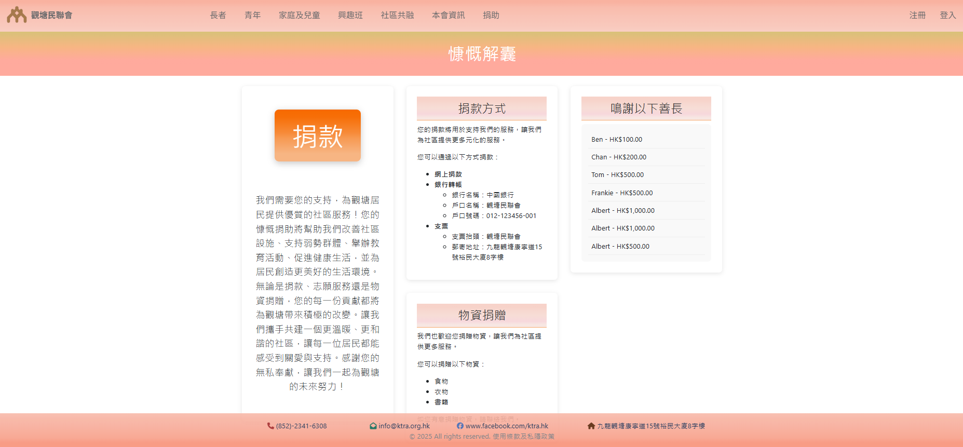
Donations page

Slide 39
Donations Flowchart
Donors
Decided to donate
online
Gmail System – Generates donation receipt / payment error email
Pay at Payment gateway
Visit Donations page
Fill Google
Form
Data input
Donation records put in the donations page to show appreciations to donors thereby encourage more donations
Google Sheet – Donation admin table
Donation records show in the donations page to appreciate donors and encourage more donations

Slide 40

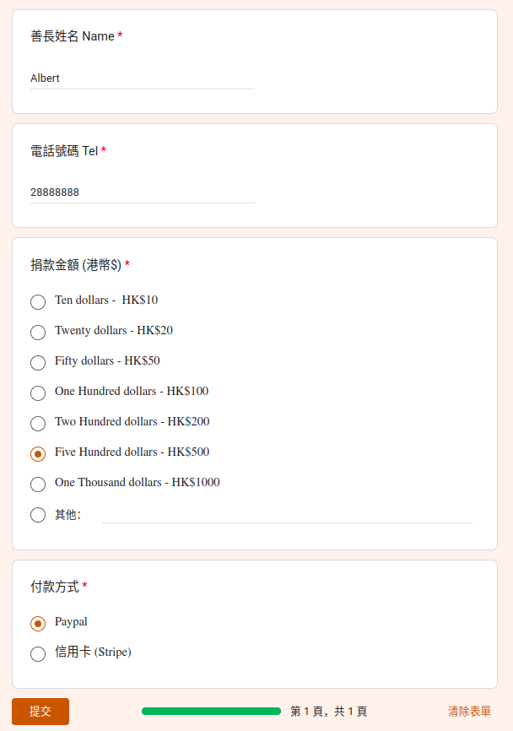
Donation form - Google form 1
Donation form p.1
1. Donor confirms his/her gmail for receiving donation receipt
2. Donor fills in
Name
Telephone
Donation Amount
Payment Method

Slide 41

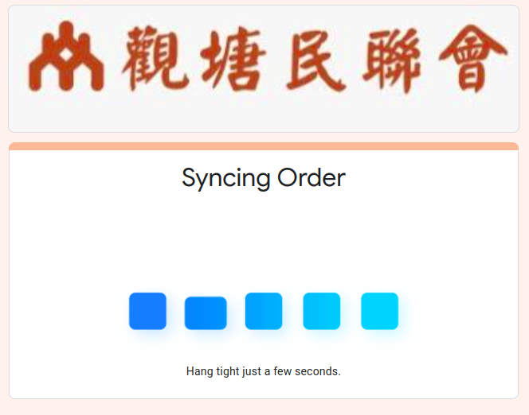
Donation form - Google form 2
Donor clicks this link to proceed payment

Slide 42
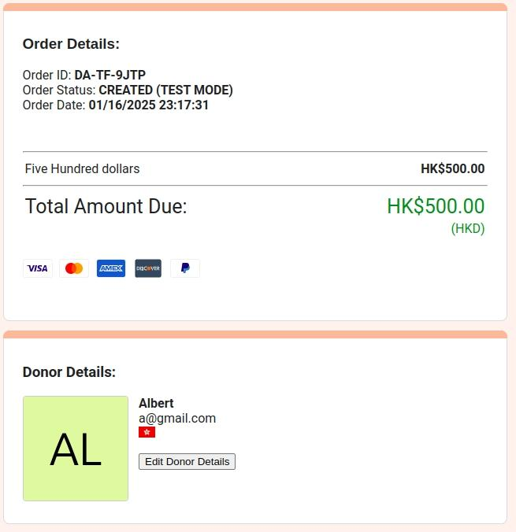
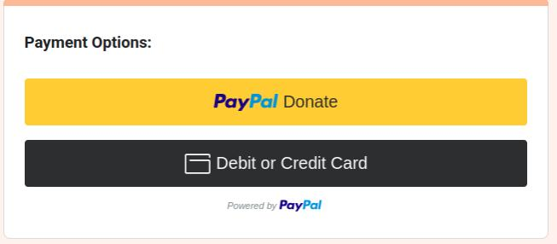



Donation form - Payment gateway
a Google Forms Add-On

Slide 43
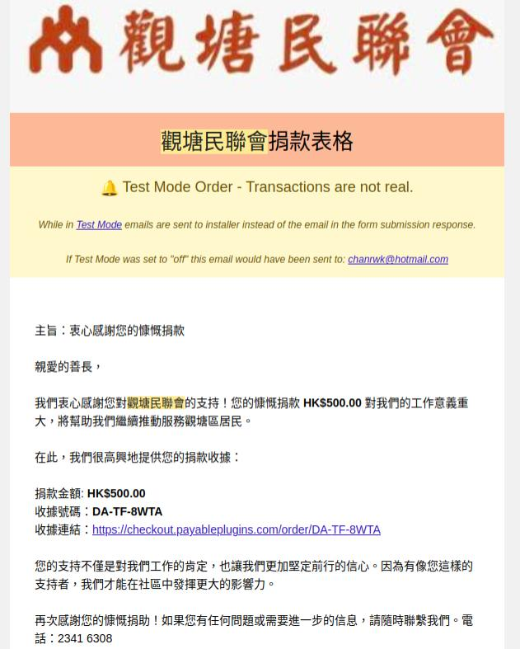
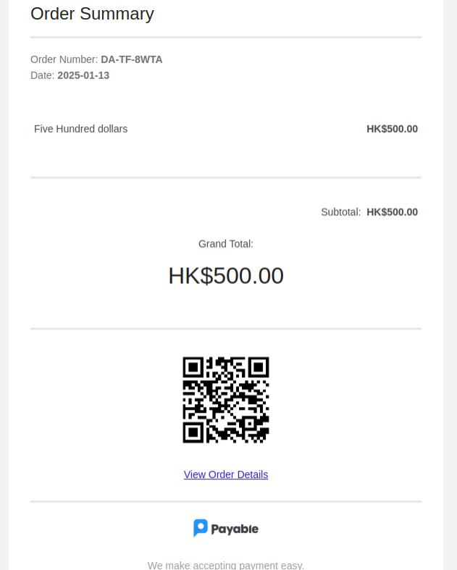
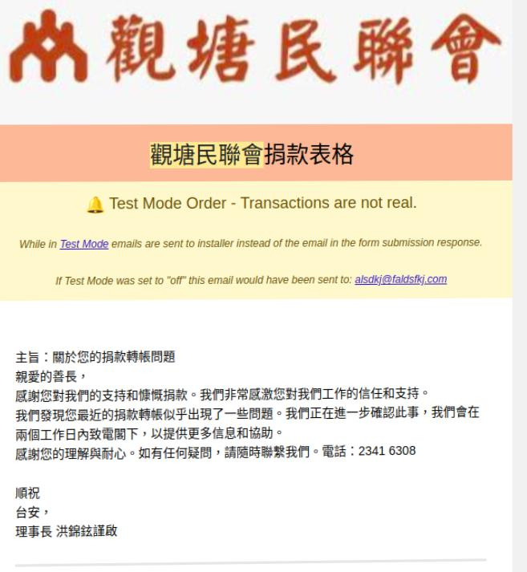
Email Receipt for Donors
Successful donation
Unsuccessful donation

Slide 44
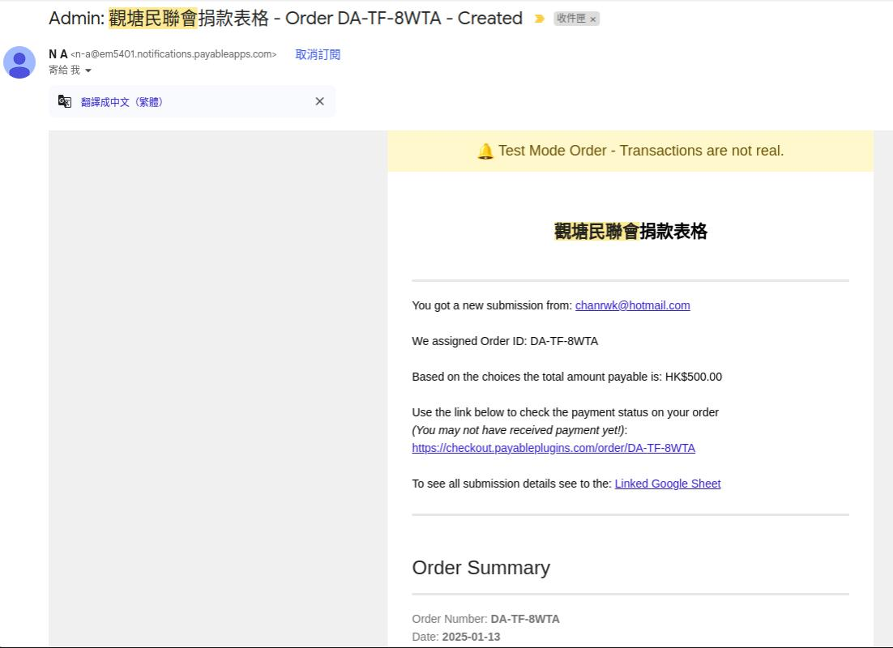
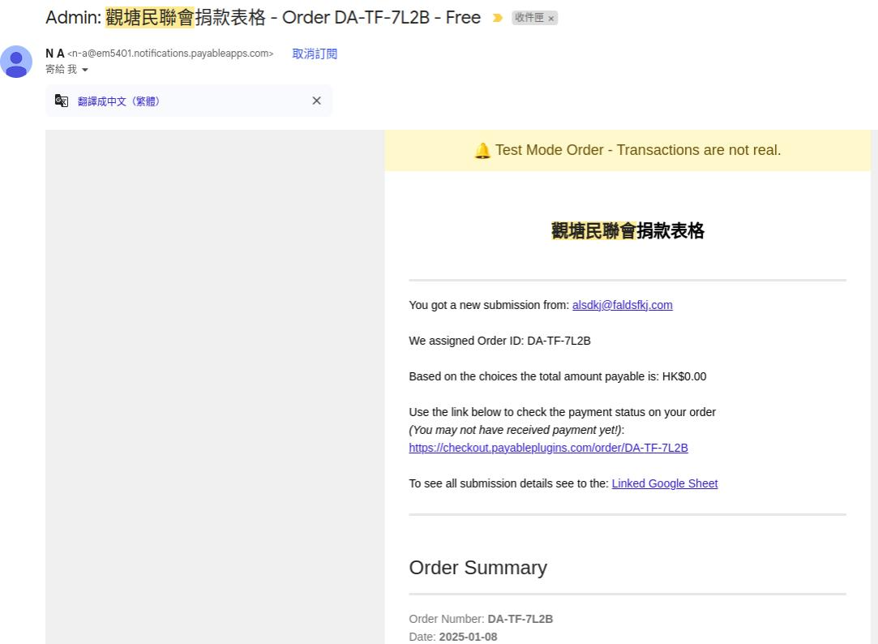
Email Notice to Admin
Successful donation
Unsuccessful donation
Successful donation
Unsuccessful donation

Slide 45
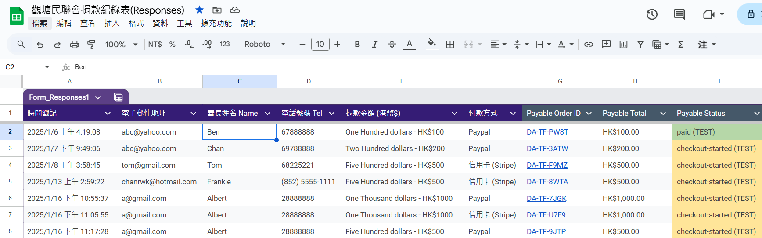
Donation Record List – Google Sheet

Slide 46
Deployment - AWS

Slide 47

Deployment
WHY AWS EC2:
Scalability:
EC2 instances can be easily scaled up or down based on demand. You can quickly adjust instance types or use Auto Scaling groups to handle varying loads.
Flexibility:
EC2 provides a variety of instance types to suit different workloads, from small applications to large-scale services. You can choose the right instance type based on CPU, memory, and storage needs.
Integration with AWS Services
AWS offers a rich ecosystem of services (like RDS for databases, S3 for storage, and CloudWatch for monitoring) that can be integrated with your EC2 instance to enhance your application.
Pay-As-You-Go Pricing:
With EC2, you pay only for the compute capacity you use. This can lead to cost savings if your application has variable usage patterns.

Slide 48
Deployment
WHY AWS EC2:
Accessibility:
EC2 instances can be accessed from anywhere, allowing for remote development and deployment. This is particularly useful for collaboration and team environments.
Security:
AWS provides robust security features, including VPCs, security groups, and IAM roles, to help you secure your application and manage access control effectively.
Docker Support:
Docker is natively supported on EC2, enabling easy deployment and management of containerized applications. You can use services like Amazon ECS or EKS for container orchestration if needed.

Slide 49
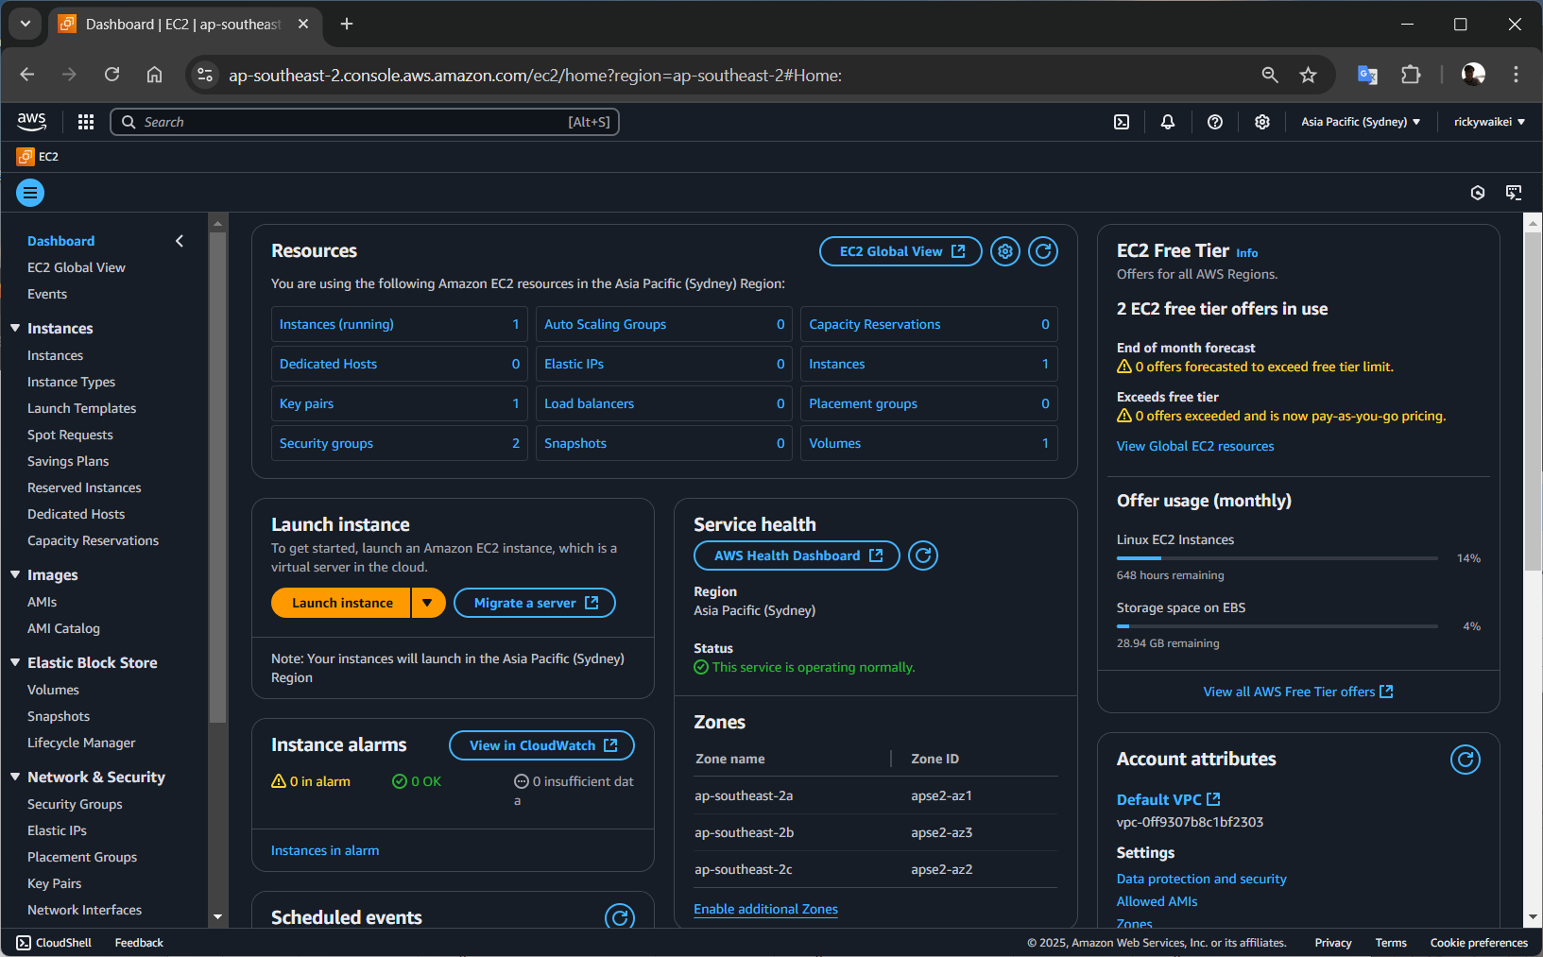

Deployment

Slide 50
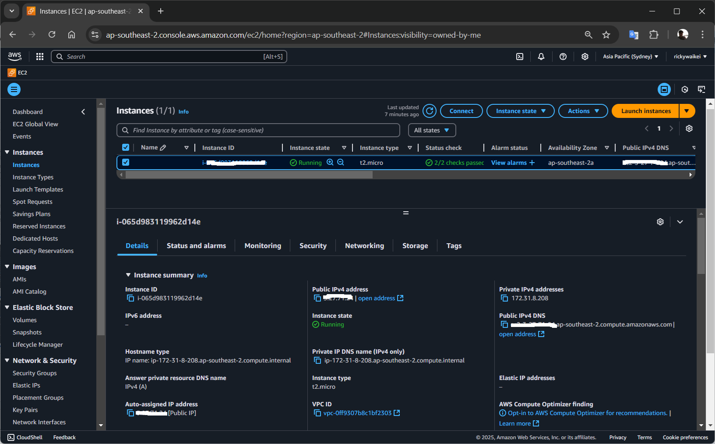

Slide 51
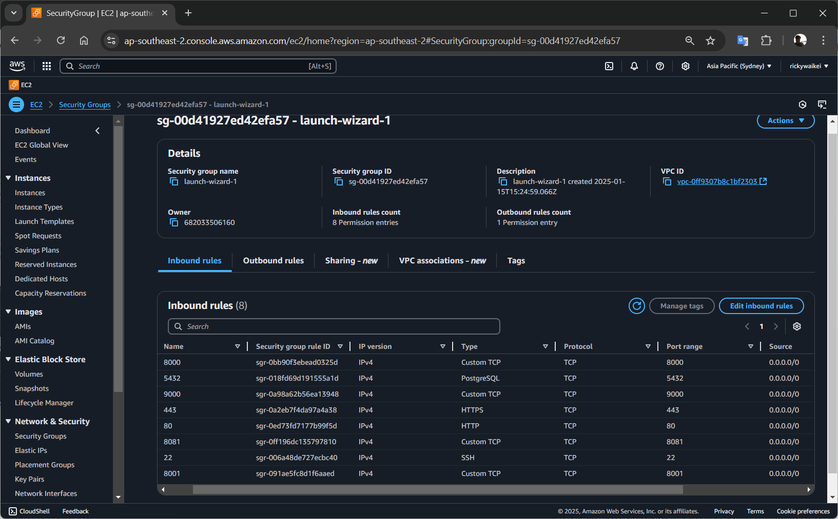

Slide 52
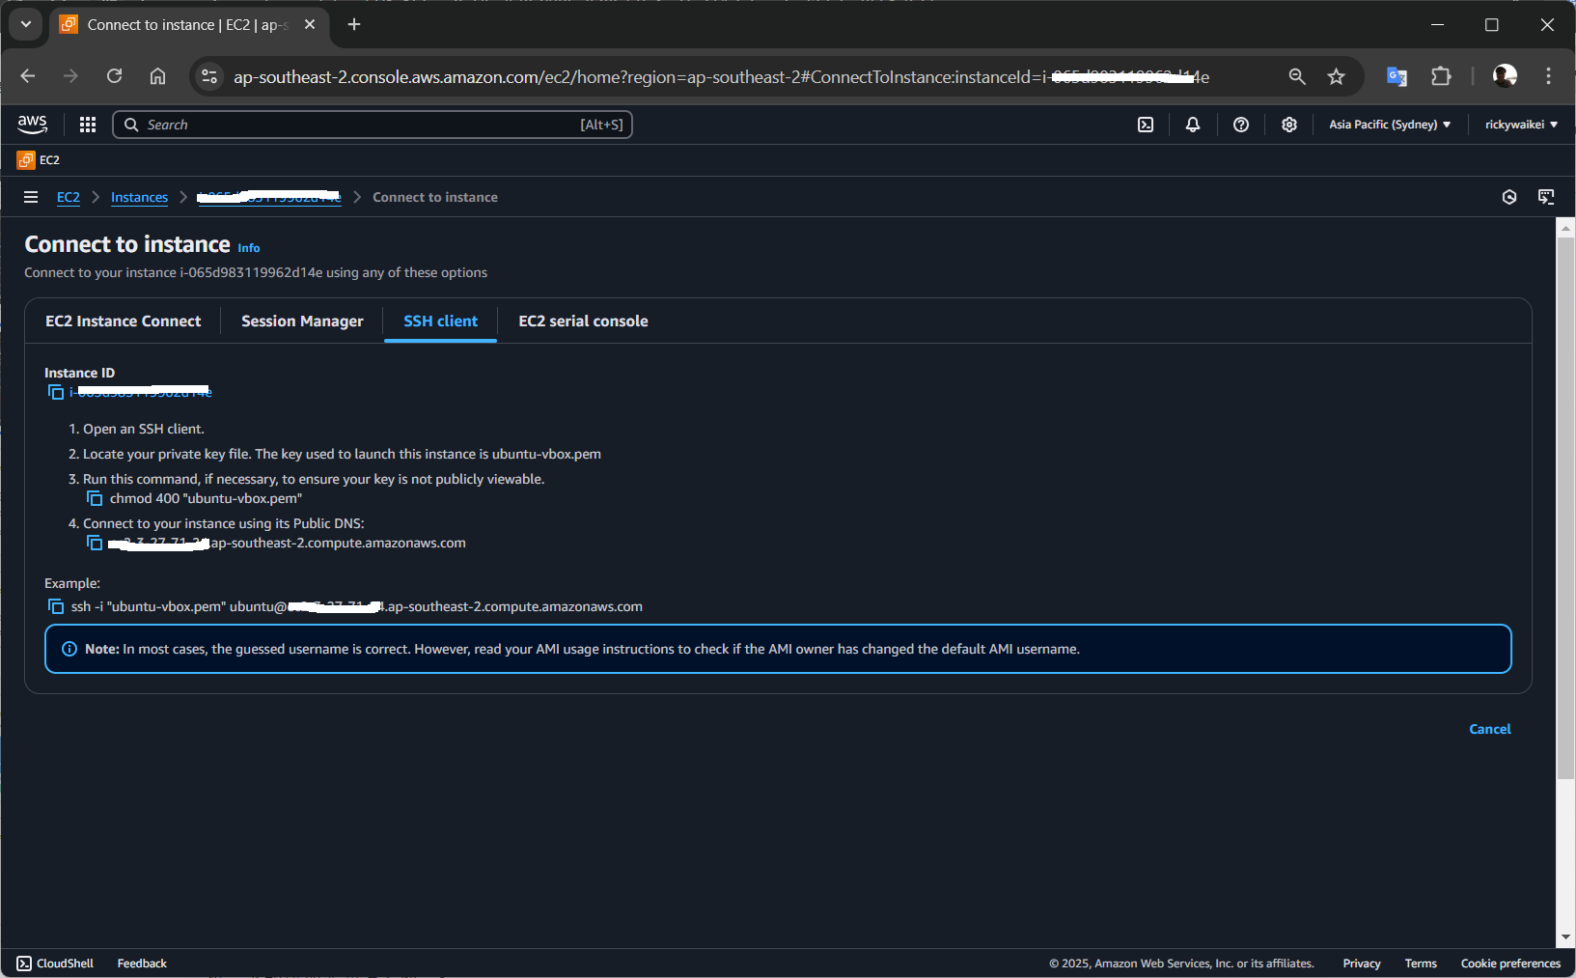

Slide 53

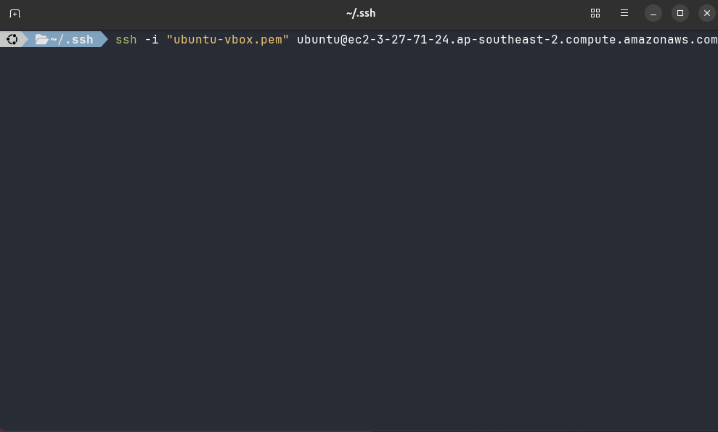
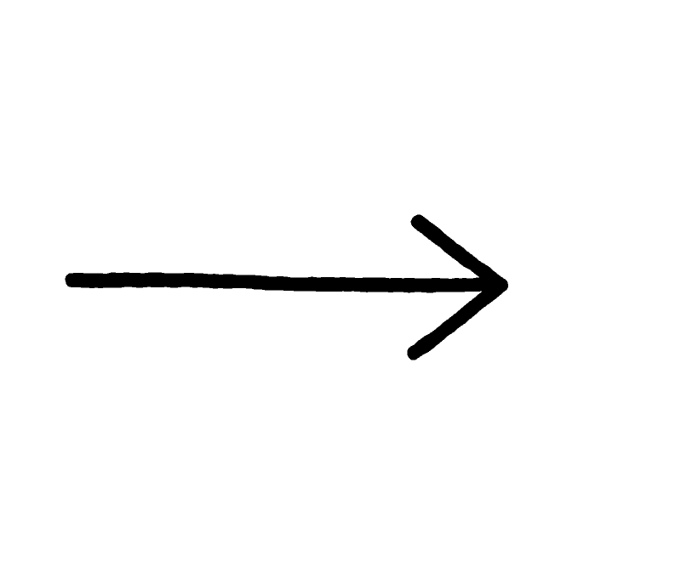
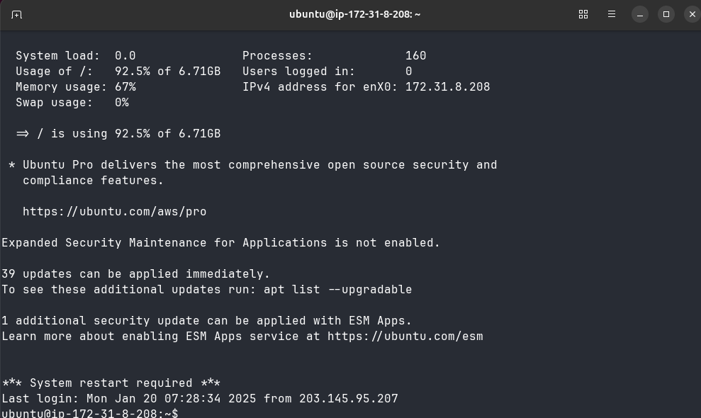
Deployment - Remote access aws vm

Slide 54
Deployment
WHY DOCKER:
Lightweight:
Docker containers share the host OS kernel, making them more lightweight than VMs, which requires a full guest operating system for each instance. This results in faster startup times and lower resource overhead.
Portability:
Docker containers can run consistently across different environments (development, testing, production), making it easier to manage deployments and reduce "it works on my machine" issues.
Isolation:
Containers provide process isolation, ensuring that applications do not interfere with each other. This is particularly useful for managing dependencies and avoiding version conflicts.

Slide 55
Deployment
WHY DOCKER:
Ease of Deployment:
Docker simplifies the deployment process through container images, allowing you to package your application and its dependencies together. This promotes consistency and reliability.
Scalability:
Docker makes it easier to scale applications horizontally by deploying multiple container instances or using orchestration tools like Kubernetes or Amazon ECS.
Resource Efficiency:
Containers typically use fewer resources than VMs, allowing you to run more applications on the same hardware.

Slide 56
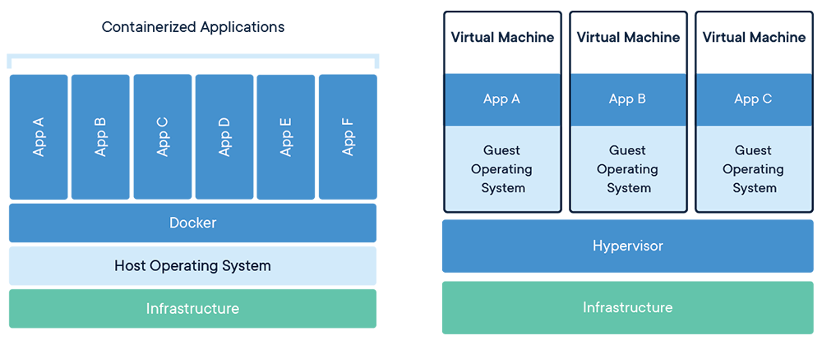
Deployment - Docker vs VM

Slide 57
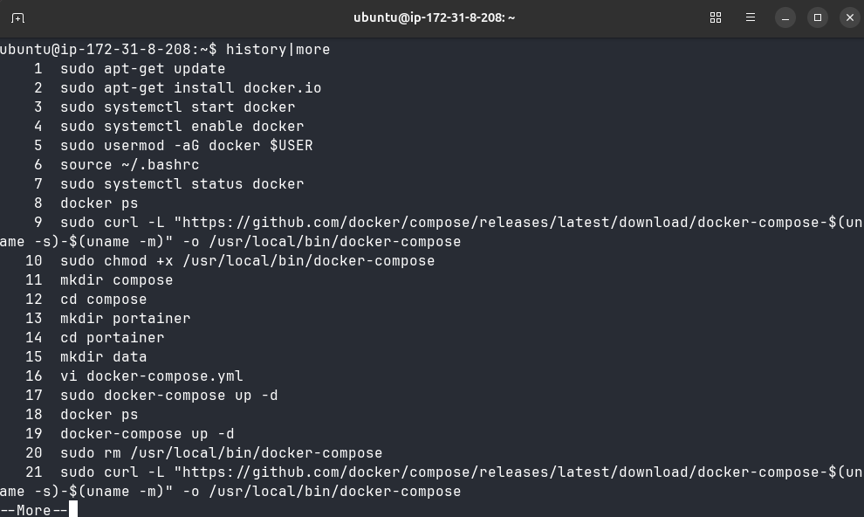
Deployment - Install Docker, Docker-compose, Portainer

Slide 58

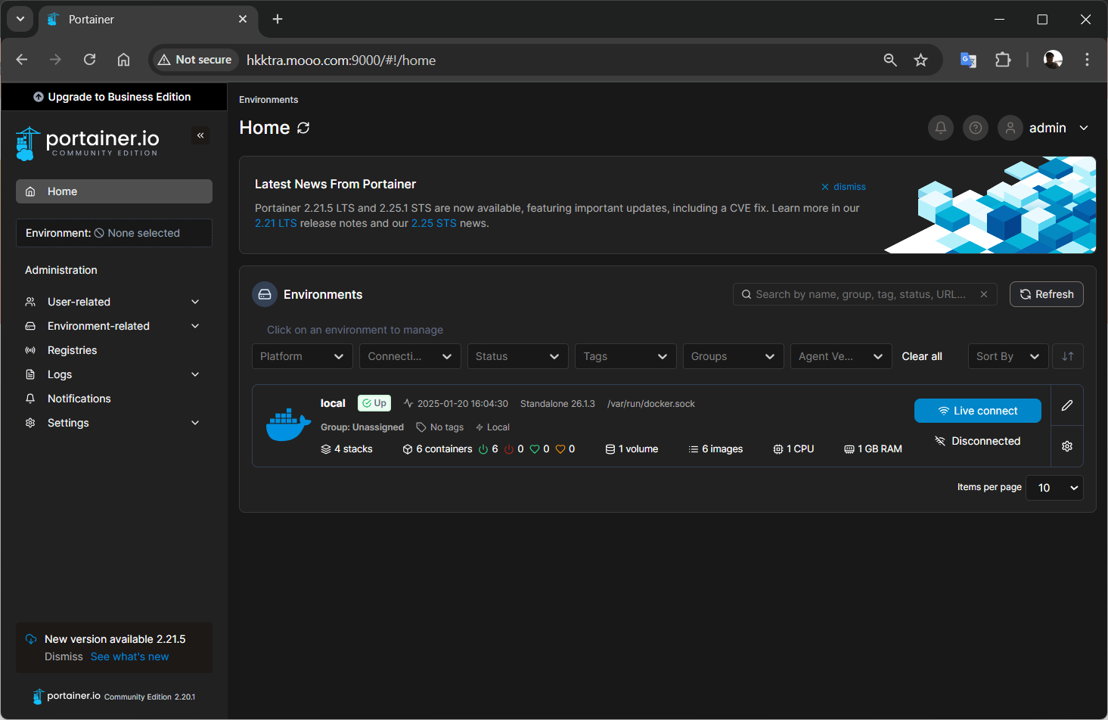
Deployment - Portainer

Slide 59

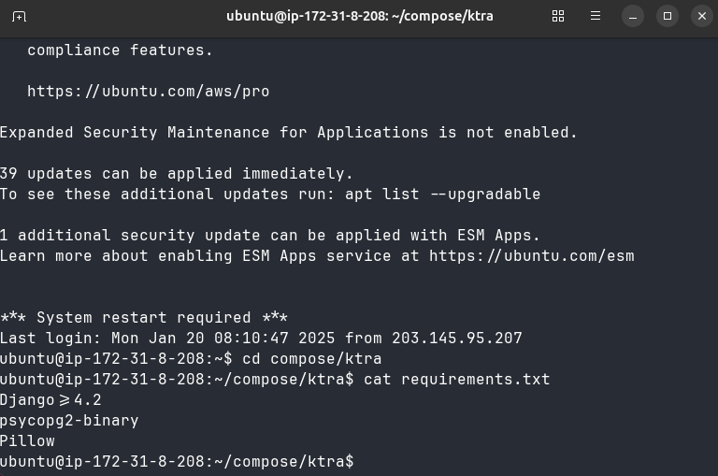
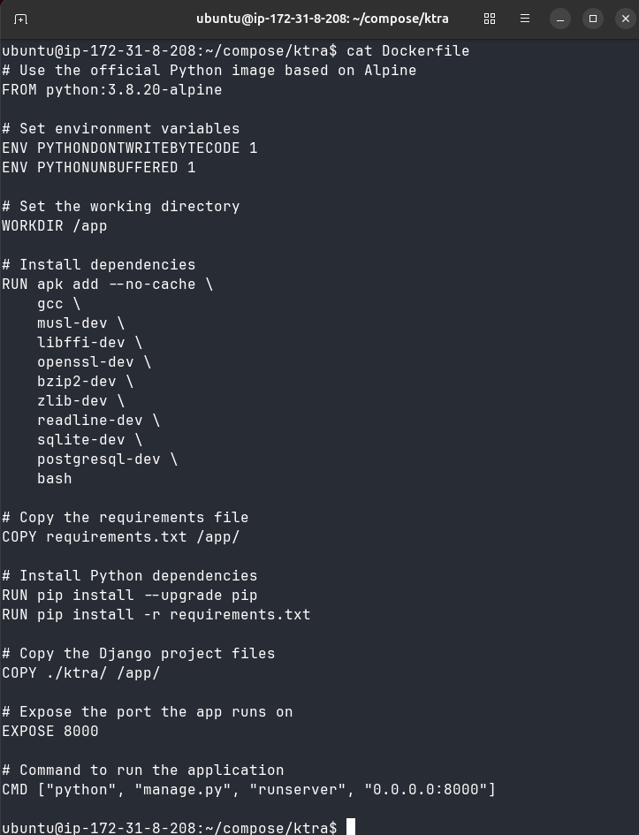
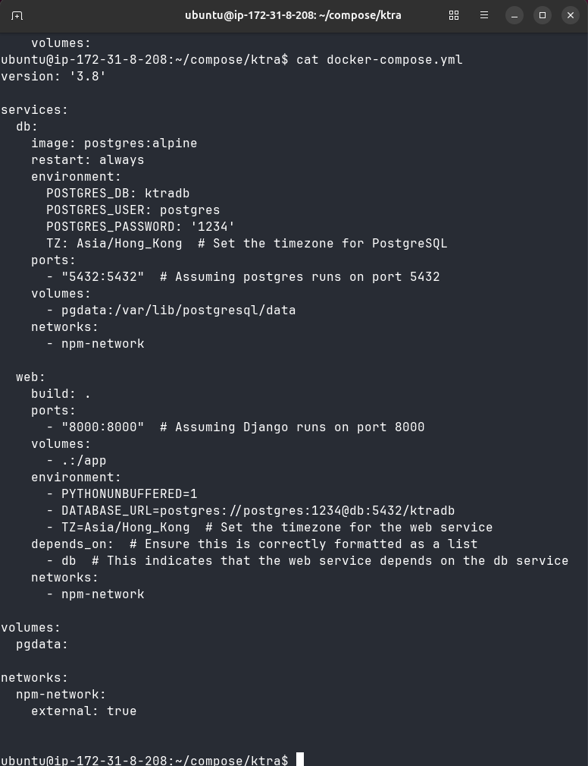
Deployment - Building Project App

Slide 60
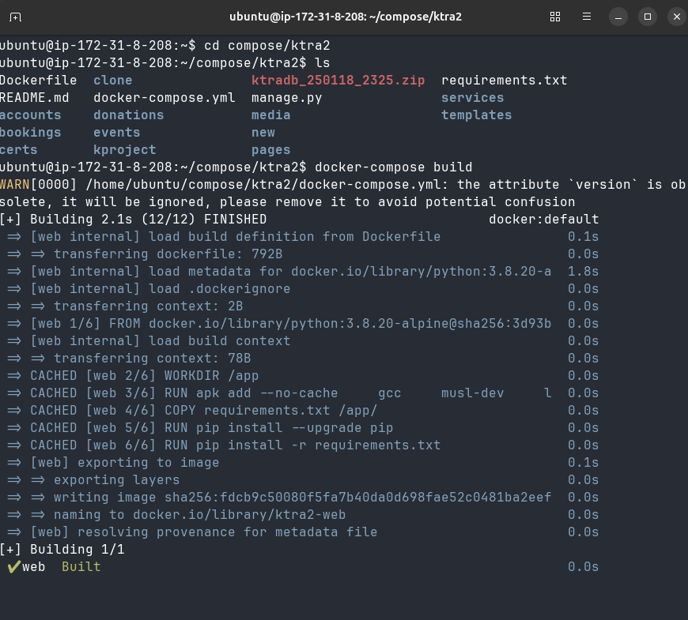
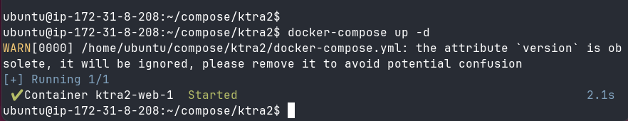
Deployment - Building and Launch

Slide 61
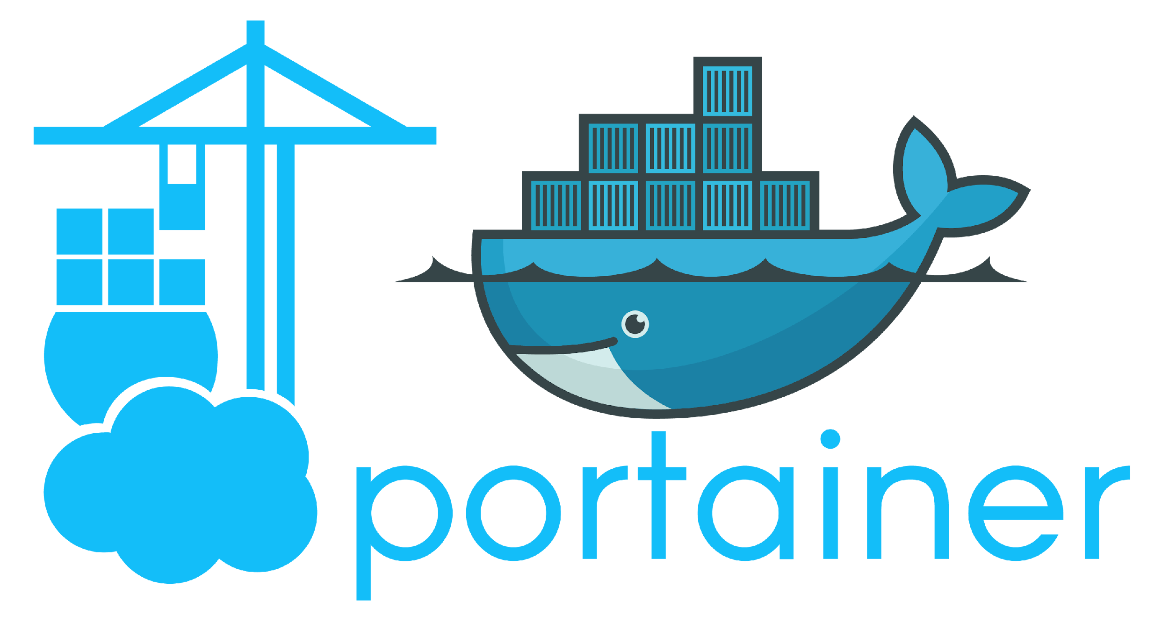
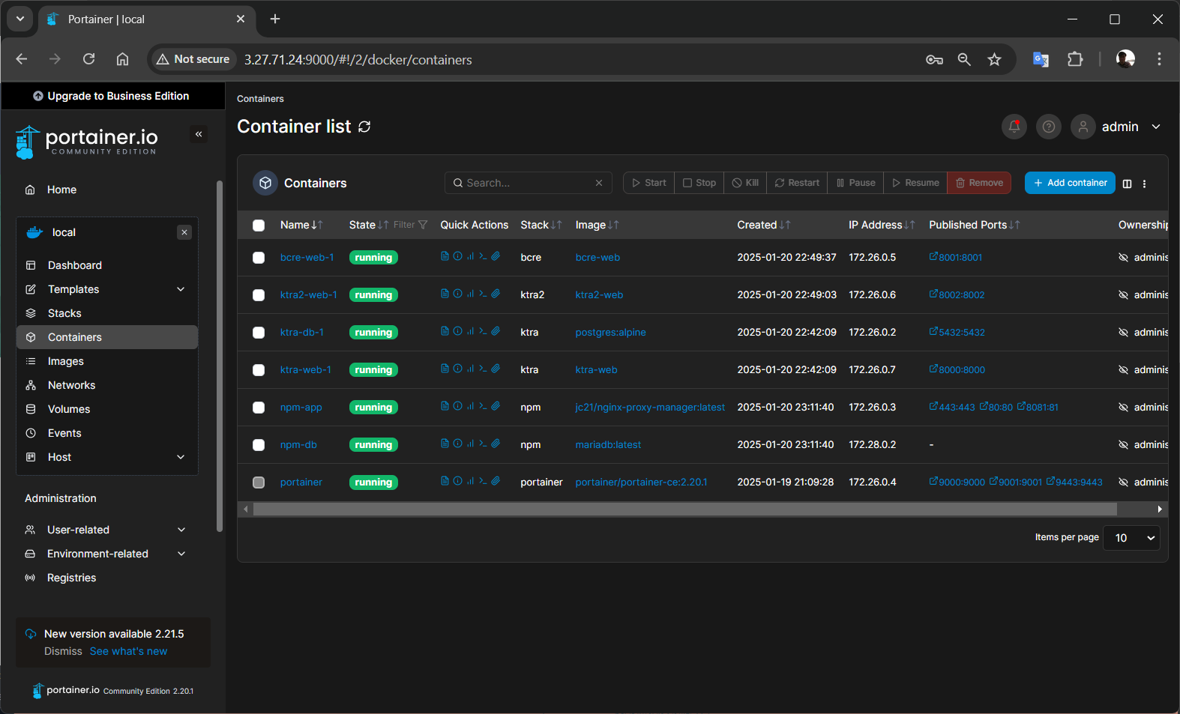
Deployment - Monitoring

Slide 62
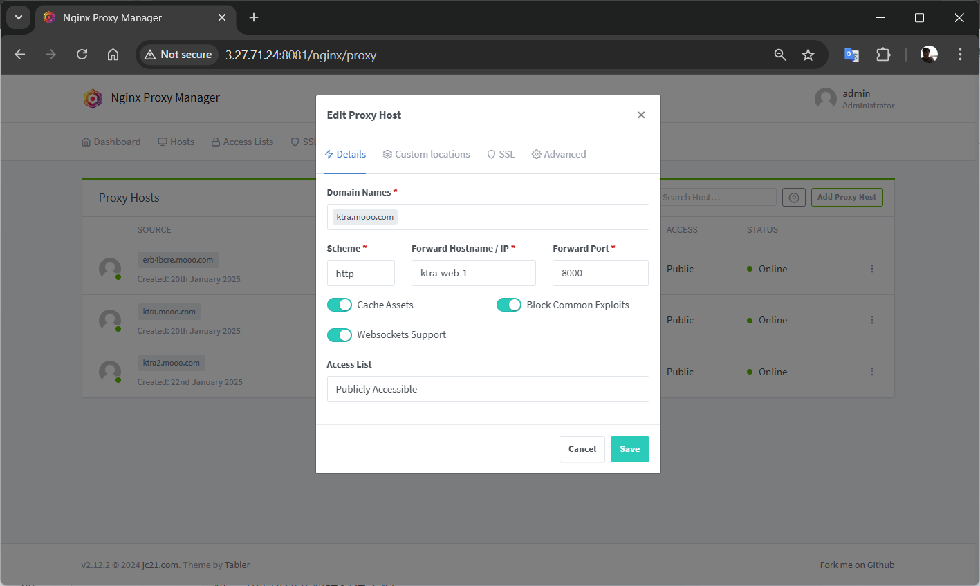
Deployment - nginx proxy manager

Slide 63
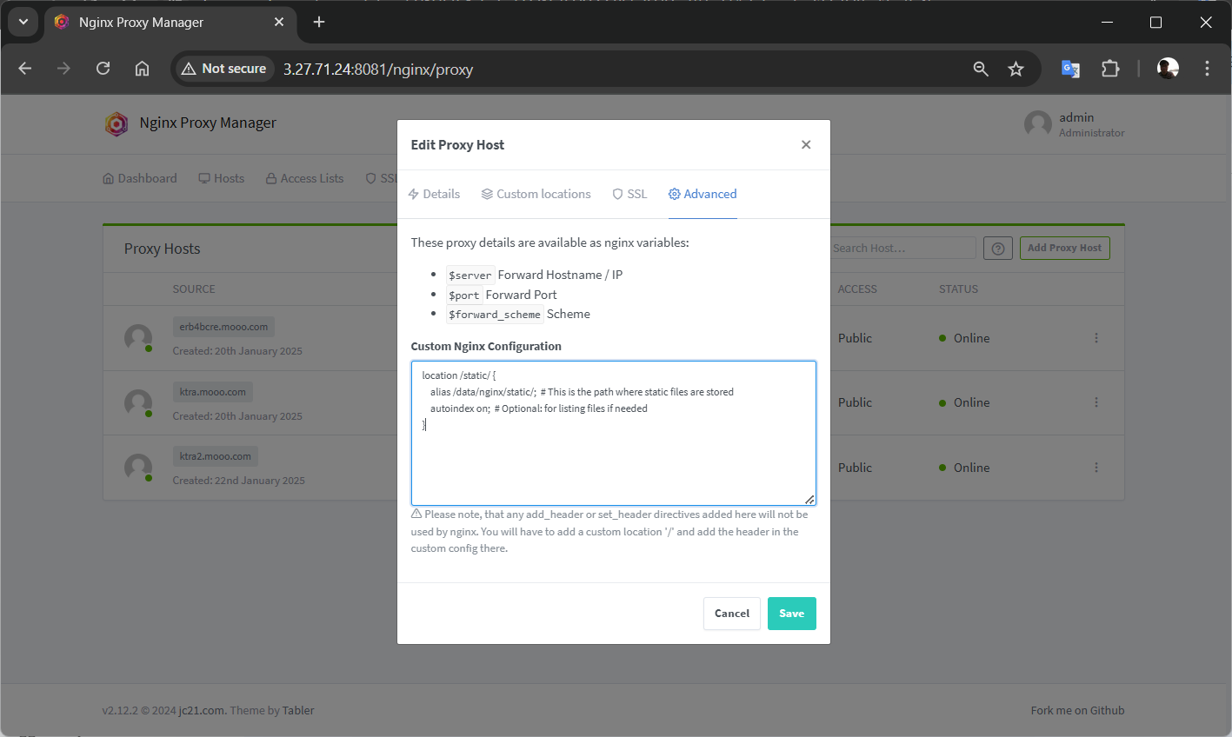
Deployment - nginx proxy manager

Slide 64
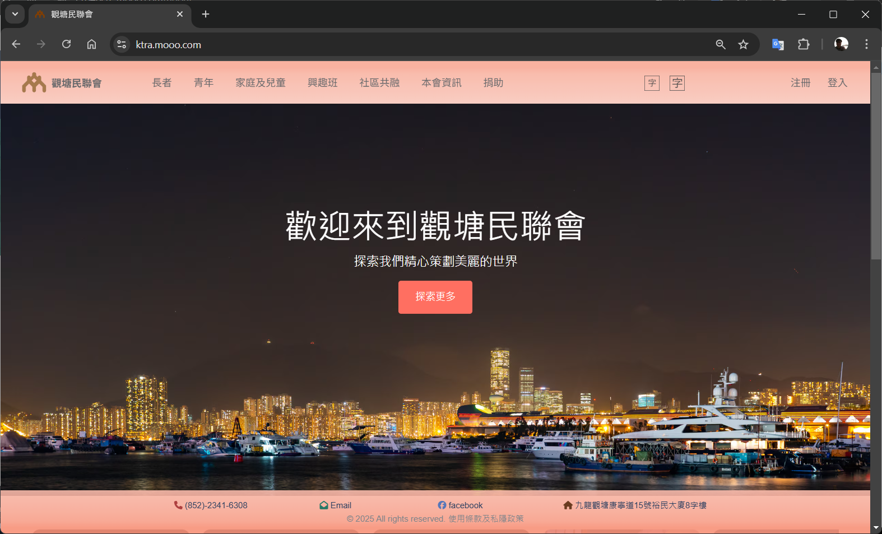
Done => Production with https (SSL)

Slide 65







Development Tools

Slide 66






AI Tools (Honorable Mentions)
Cursor
Windsurf
Cody
Cline
Supermaven
Continue
DeepseekV3

Slide 67
Questions & answers

